Slide 1
Amharic–English Neural Machine Translation
Data Collection & Preprocessing Milestone
Yohannis zewde

Slide 2
Project Roadmap & Milestones
section 1 PROJECT ROADMAP — ALL MILESTONES
Milestone 1 — Data Collection & Preprocessing
1st Finished — 207,885 sentence pairs collected, cleaned, tokenized & formatted for training
Milestone 2 — Transformer Architecture Initialization
Built entirely from scratch in PyTorch — no pre-trained weights, no HuggingFace Transformers library
Milestone 3 — Model Training on Workstation
Full training loop on local GPU — multi-epoch training with learning rate scheduling & checkpointing
Milestone 4 — Inference & Evaluation
BLEU score evaluation, beam search decoding, translation quality benchmarks on held-out test set
Milestone 5 — API Deployment
Package as production-ready REST API — real-time Amharic–English translation endpoint

Slide 3
The Ultimate Goal
SECTION 2 — PROJECT OVERVIEW
Build a highly accurate Amharic–English translation model and package it as a REST API a
bridge so other web and mobile apps can easily use our translator.
The Architecture — Seq2Seq Transformer from Scratch
No Language Left Behind. A state-of-the-art open-source model specifically built to rescue
low-resource languages.
Why It Matters
Amharic has 30M+ speakers but is digitally underserved. Improving Amharic NMT removes
educational and economic barriers.

Slide 4
Gathering the Building Blocks
S E C T I O N 3 — D A T A s o u r c e s
In Machine Learning, data is food.
A model is only as smart as the examples it consumes.
STARTED WITH
CURRENT DATASET
2,000
380K+
19,000% increase
sentence pairs
pristine parallel pairs

Slide 5

Where Did the Data Come From?
S E C T I O N 3 — D A T A S O U R C E S
Religious Texts
Bible, JW300 — highly consistent, professionally translated.

Slide 6
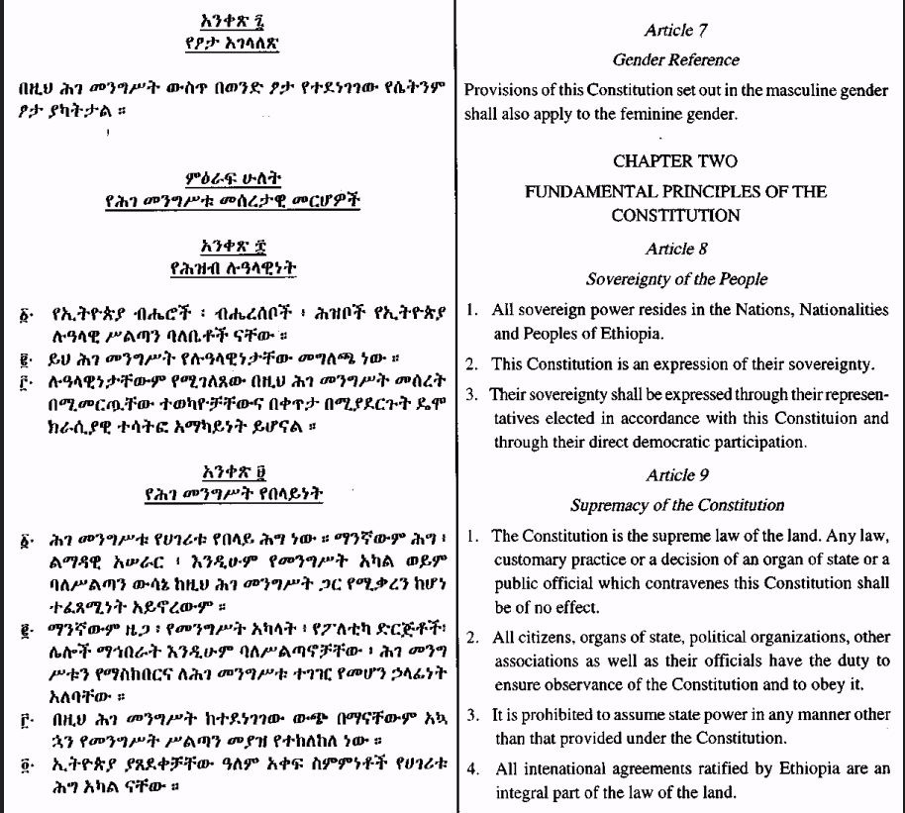
Legal & Law Books
Strict, formal, and precise terminology.

Slide 7
Colloquial Datasets
Conversational text to teach the model how people actually speak.

Slide 8
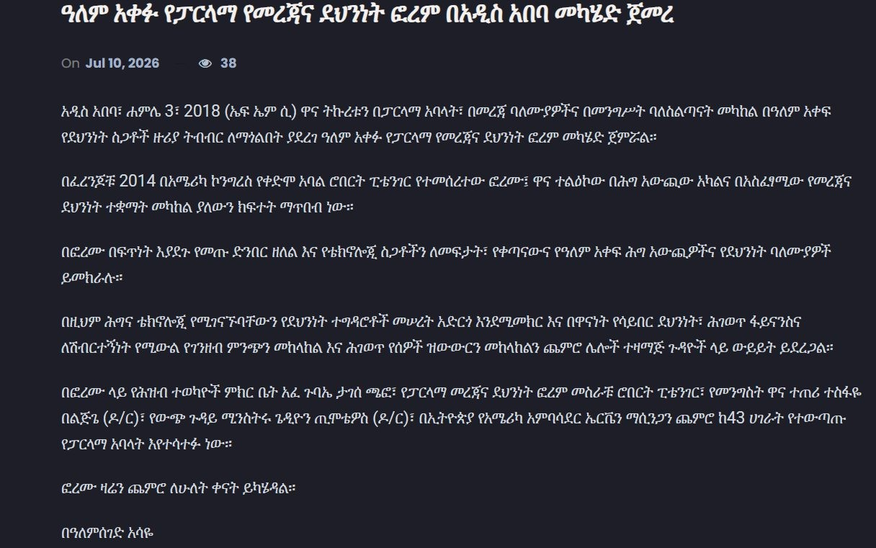

News Articles
Multilingual news for modern vocabulary & current events.

Slide 9
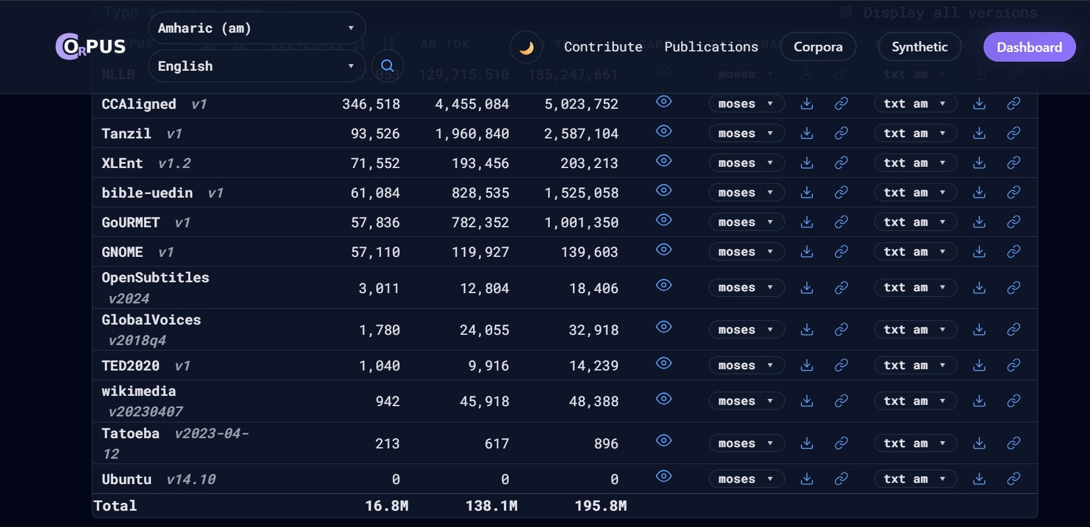
Web-Scraped Data
OPUS / Common Crawl — massive, varied internet text.

Slide 10
Local & Creative Sources
S E C T I O N 3 — E T H I O P I A N C O N T E X T
Corporate Digital Services & Apps
Scraping bilingual app localizations, user manuals, and Terms of Service from major local entities
— Ethio Telecom / Telebirr, Commercial Bank of Ethiopia, Ethiopian Airlines. These companies maintain high-quality English and Amharic versions of identical text.
Local Media Subtitles & Transcripts
Harvesting transcripts from bilingual YouTube creators and closed-captioning files from local TV networks (Kana TV, EBS) that regularly translate international content.

Slide 11
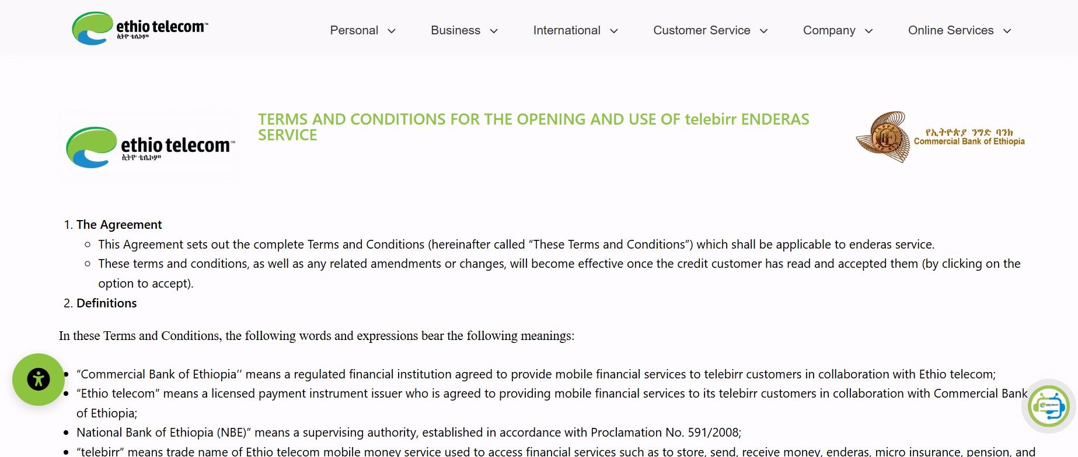
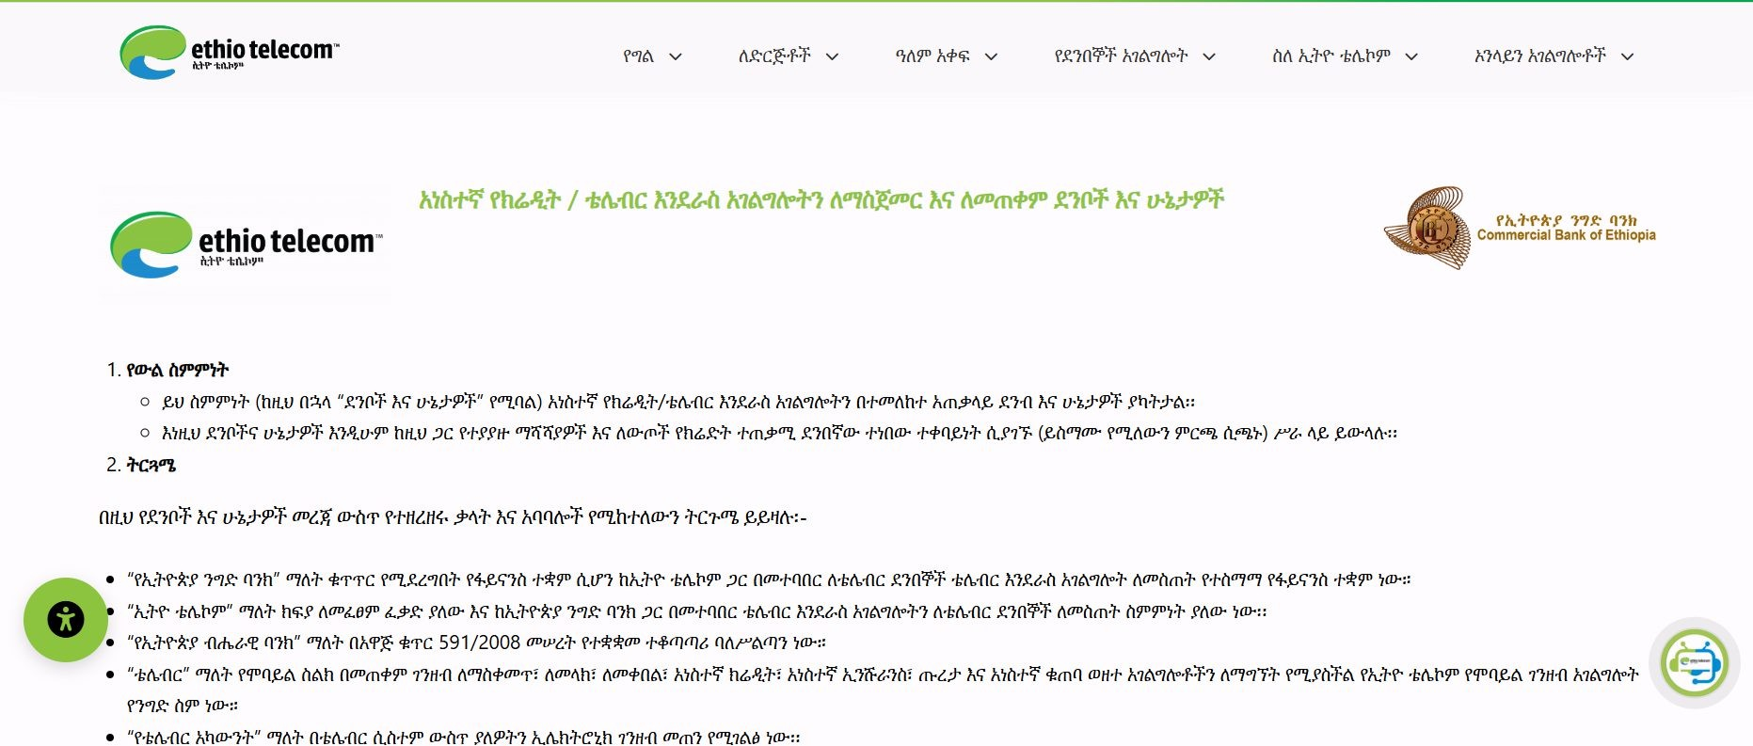

Slide 12
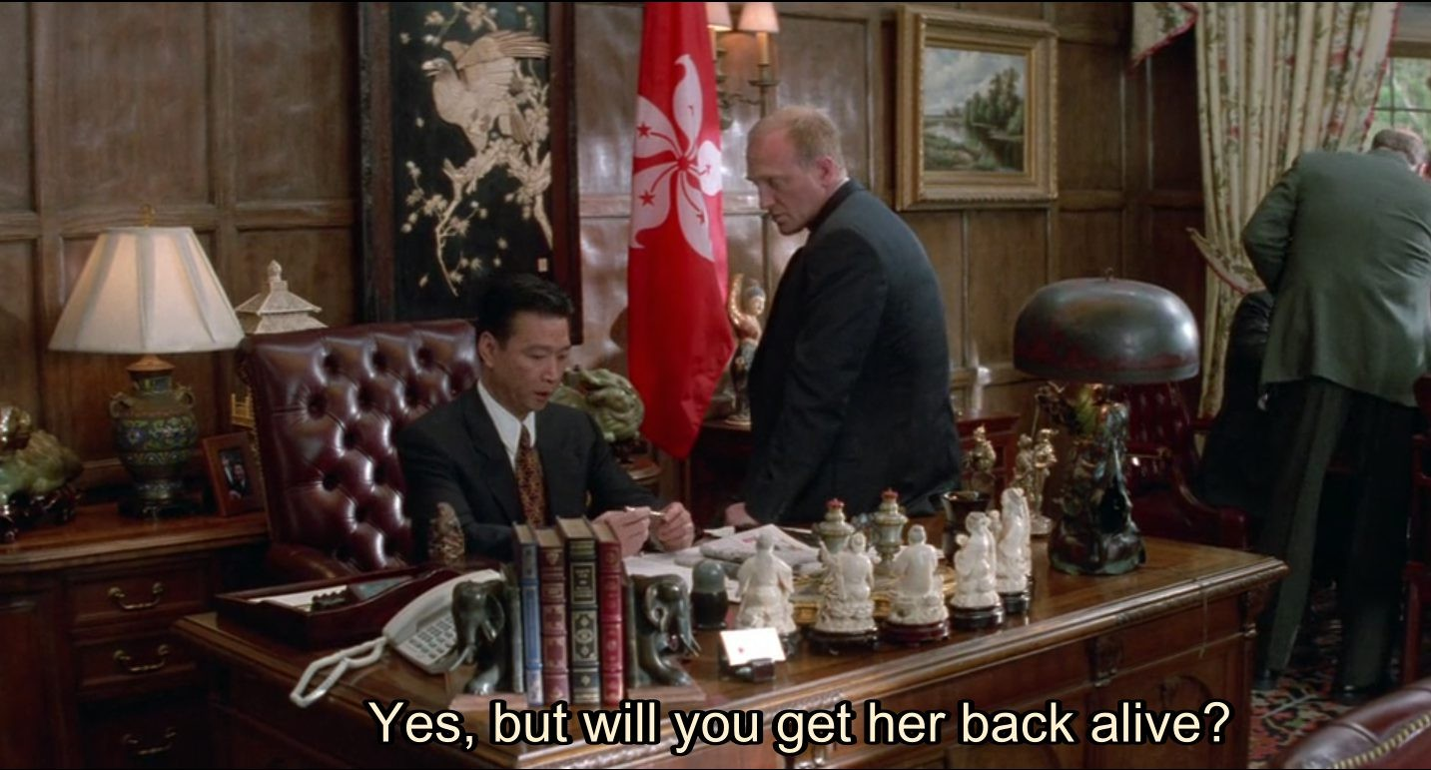
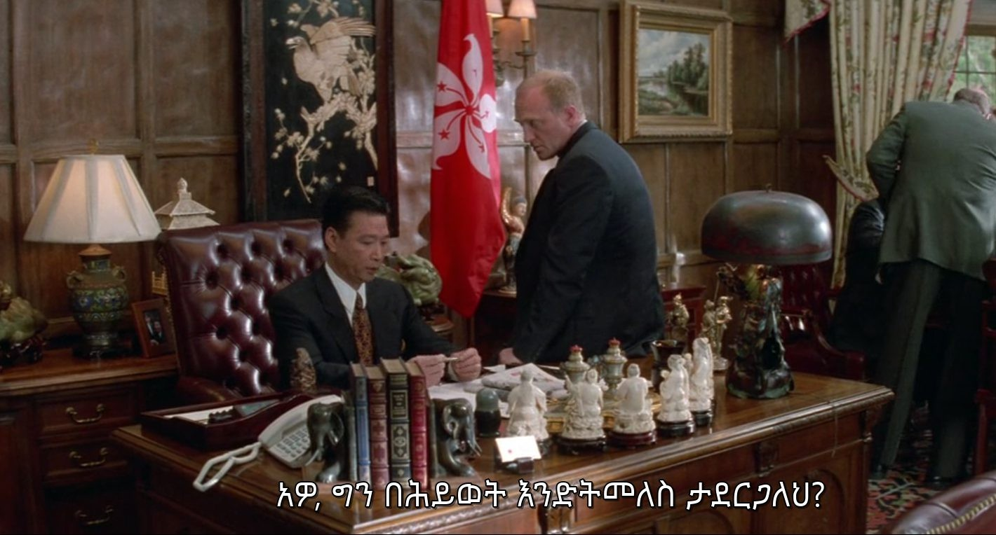
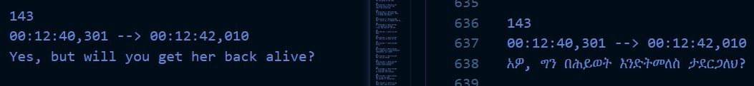

Slide 13
Core Preprocessing Philosophy & Goals
S E C T I O N 4 — D A T A P R E P R O C E S S I N G
The “Garbage In, Garbage Out” Rule: Models learn directly from parallel examples. Quality data overrides architecture size.
Goal 1: Noise Removal & Lexicon Purge Eliminate subtitle timing markers, speaker labels, empty lines, and mismatched language strings.
Goal 2: Optimizing Subword Vocabulary Standardize spacing and punctuation to ensure cleanly aligned token boundaries for SentencePiece BPE.
Goal 3: VRAM Out-of-Memory Protection Filter out sequence lengths exceeding 100 words to safeguard GPU performance during training epochs.
Goal 4: Scientific Length Stratification Balance sequence lengths across splits so validation accurately represents true test distributions.

Slide 14
The Merging Pipeline: Aggregating 4 Parallel Corpora
S E C T I O N 4 — D A T A P R E P R O C E S S I N G
Data Sources Joined
General Corpus: AmharicDataset (5K pairs) · Web Crawls: OPUS-100 (200K pairs) · Benchmarks: FLORES-200 (1K pairs) · Religious Texts: Bible parallel corpus (30K pairs)
Harmonizing the Schema
Converting mismatched Excel spreadsheets and CSV sources into a unified two-column layout: ‘amharic’ and ‘english’ columns.
Pre-cleaning Filters
Automated drop of null cells and completely empty spacing strings to establish a normalized primary raw dataset.

Slide 15
Pass 1: Eliminating Structural & Subtitle Noise
S E C T I O N 4 — D A T A P R E P R O C E S S I N G
Speaker Label Strip
Regular expressions (regex) to strip conversational speaker tags (e.g., CARTER:, ሰው:) from subtitle dialogues.
Ellipsis Paring
Cleaning leading/trailing ellipsis artifacts (…, ...) typical of streaming transcription and subtitle data.
Length Ratio Filter
Dropping rows where the word-count ratio between source and target is highly skewed (ratio < 0.5 or > 2.0).
Initial Deduplication
Drop duplicate phrases on both source and target sides to prevent the network from memorizing repeated dialogues.

Slide 16
Pass 2: Language Purification & Noise Stripping
S E C T I O N 4 — D A T A P R E P R O C E S S I N G
Geʼez Unicode Verification
Checking that Amharic column contains valid characters within the Geʼez script block (U+1200 to U+137F).
Leakage Filtration
Dropping rows where the Amharic column is corrupted with more than 30% English/Latin text (language leakage).
Underscore & Noise Clean
Removing stray characters like mid-word underscores (_) or system codes that corrupt token representations.
Punctuation Standardization
Cleaning standalone hyphens used for dialogue turn-taking indicators, ensuring only clean letters remain.

Slide 17
Normalizing Orthographic Conventions
S E C T I O N 4 — D A T A P R E P R O C E S S I N G
Amharic Normalization
Collapsing double Ethiopic colons (::) into a standardized Ethiopic full stop (።). Replacing single colons (:) with the traditional word space marker (፡).
English Normalization
Converting all English text to lowercase to limit vocabulary size. Stripping non-ASCII formatting while retaining letters, numbers,
spaces, apostrophes, and common punctuation.
Whitespace Management
Collapsing extra consecutive spaces and trimming sentence margins to ensure consistent token boundary detection.

Slide 18
Sequence Length Controls for Training Stability
S E C T I O N 4 — D A T A P R E P R O C E S S I N G
Transformer Memory Cost
Core memory increases quadratically with sentence length: O(L²). A sentence of 200 words uses four times more GPU memory than one of 100 words.
Outlier Culling
Dropping any sentences exceeding 100 English words. Only removes a tiny fraction of extreme outliers but provides absolute
safety against VRAM spikes.
Max Sequence Cap
Setting the dynamic padding tokenizer configuration to max_length = 128 tokens for stable batched training across all epochs.

Slide 19
Length-Based Stratification & Dataset Splitting
S E C T I O N 4 — D A T A P R E P R O C E S S I N G
Split Layout: 95% Training · 2.5% Validation · 2.5% Testing
The Challenge of Length Mismatch
Standard random splitting can lead to mismatched average sentence lengths, causing skewed training loss curves.
Quantile Bucketing
Sorting data into 5 structural length buckets based on word counts: very short, short, medium, long, and very long.
Stratified train_test_split
Splitting using Scikit-Learn’s stratified sampler to ensure identical length distributions in Train, Val, and Test sets.
Result: Train, Validation, and Test sets have the exact same shape and difficulty distribution.

Slide 20
Subword Tokenization via Byte-Pair Encoding
S E C T I O N 4 — D A T A P R E P R O C E S S I N G
Shared BPE Vocabulary
Model learns token merges on both Amharic and English text simultaneously, enabling cross-lingual subword sharing.
Vocab Size: 32,000 Tokens
A 32K vocabulary balances coverage of both Amharic morphology and English vocabulary without excessive sparsity.
Linguistic Protection: character_coverage = 0.9995
Guarantees all Geʼez script character variants are covered, preventing unknown token (<unk>) errors during translation.
Special Tokens
Four reserved tokens define the sequence contract: <pad>=0 (padding), <unk>=1 (unknown), <s>=2 (start), </s>=3 (end).

Slide 21
Preprocessing Pipeline Metrics & Efficacy
S E C T I O N 4 — D A T A P R E P R O C E S S I N G
R A W C O L L E C T E D
C U R A T E D & C L E A N
~500K
lines collected
~380K
pristine parallel pairs
24% pruned
TRAIN SET
360K+
pairs after deduplication
VALIDATION SET
10K+
pairs
TEST SET
10K+
pairs

Slide 22
Data Engineering: The Real Engine of Modern AI
S E C T I O N 4 — D A T A P R E P R O C E S S I N G
The 80/20 Practice Rule
80% of machine learning success lies in data pipeline engineering. Only 20% lies in hyperparameter tuning. Anyone can download a Transformer model — the real engineering is in the data.
Low-Resource Language Adaptability
Developing custom cleaning pipelines is mandatory when handling under-digitized languages like Amharic where no pre-
existing standard dataset exists.
Direct Impact on Model Performance
This preprocessing pipeline directly resolved the initial training loop’s degenerate output, resulting in a successful loss
drop to <b>2.96</b> and a functioning translator.

